Slide 1
Time Series Data – Part 1 Schema Design
@jayrunkel
Jay Runkel
Solutions Architect, MongoDB

Slide 2
Our Mission Today

Slide 3
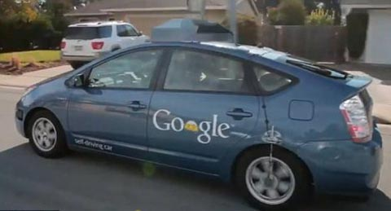
We need to prepare for this

Slide 4
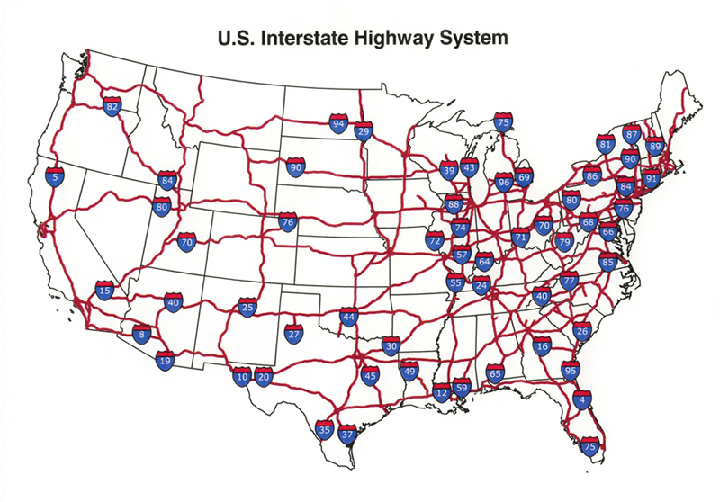
Develop Nationwide traffic monitoring system

Slide 5
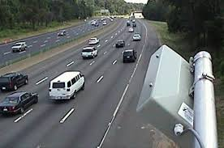

Slide 6
Traffic sensors to monitor interstate conditions
16,000 sensors
Measure
Speed
Travel time
Weather, pavement, and traffic conditions
Support desktop, mobile, and car navigation systems

Slide 7
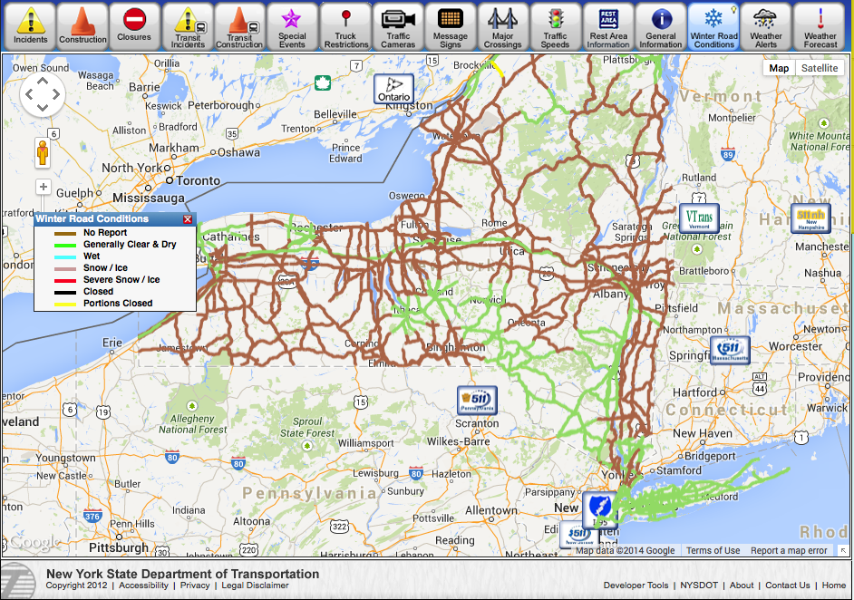
Model After NY State Solution

Slide 8
Other requirements
Need to keep 3 year history
Three data centers
NJ, Chicago, LA
Need to support 5M simultaneous users
Peak volume (rush hour)
Every minute, each request the 10 minute average speed for 50 sensors

Slide 9
Master Agenda
Successfully deploy a MongoDB application at scale
Use case: traffic data
Presentation Components
Schema Design
Aggregation
Cluster Architecture

Slide 10
Time Series Data Schema Design

Slide 11
Agenda
Similarities between MongoDB and Olympic weight lifting
What is time series data?
Schema design considerations
Analysis of alternative schemas
Questions

Slide 12
Before we get started…

Slide 13


Slide 14
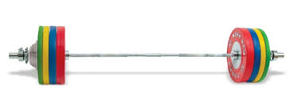
Lifting heavy things requires
Technique
Planning
Practice
Analysis
Tuning

Slide 15

Without planning…

Slide 16


Slide 17
Tailor your schema to your application workload

Slide 18
Time Series
A time series is a sequence of data points, measured typically at successive points in time spaced at uniform time intervals.
Wikipedia
time
0
2
4
6
8
10
12

Slide 19
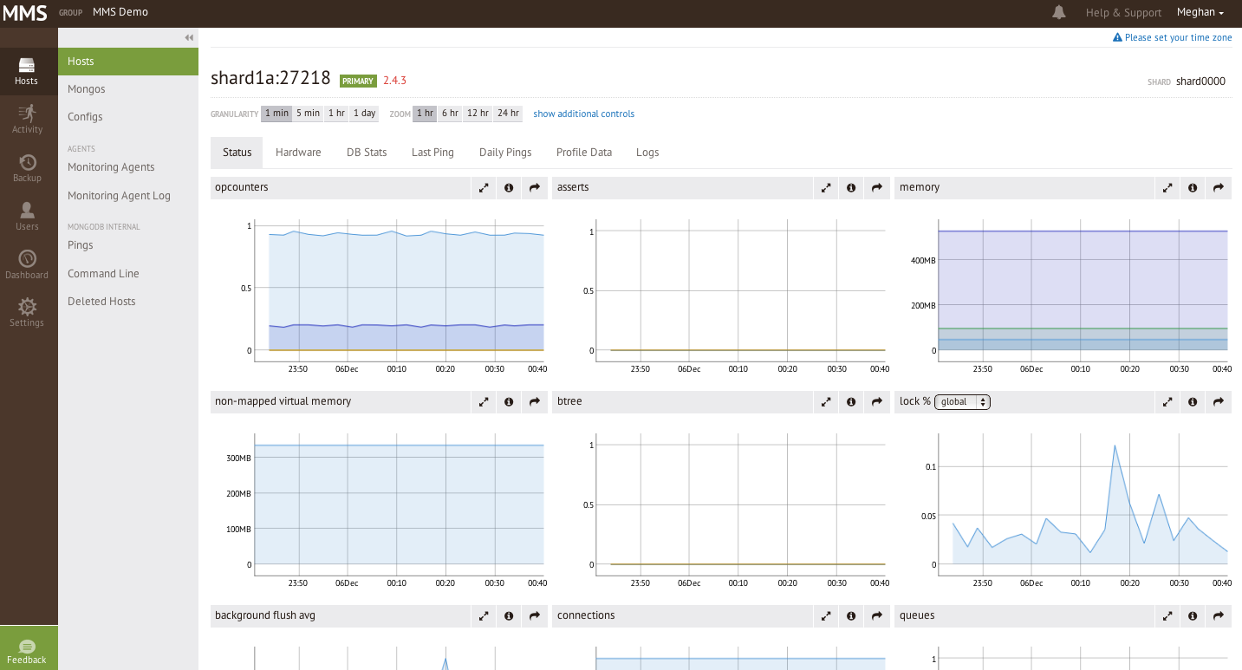
Time Series Data is Everywhere

Slide 20
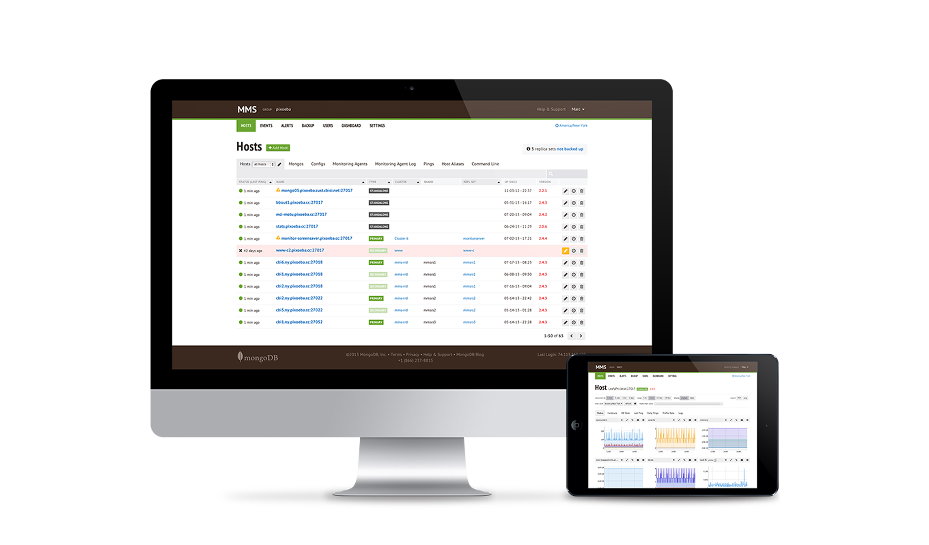
Example: MongoDB Monitoring Service
Free hosted service for monitoring MongoDB systems
100+ system metrics visualized and alerted
25,000+ MongoDB systems submitting data every 60 seconds
90% updates, 10% reads
~75,000 updates/second
~5.4B operations/day
8 commodity servers

Slide 21
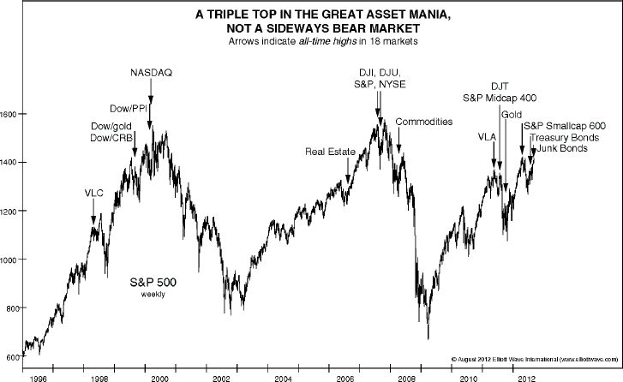
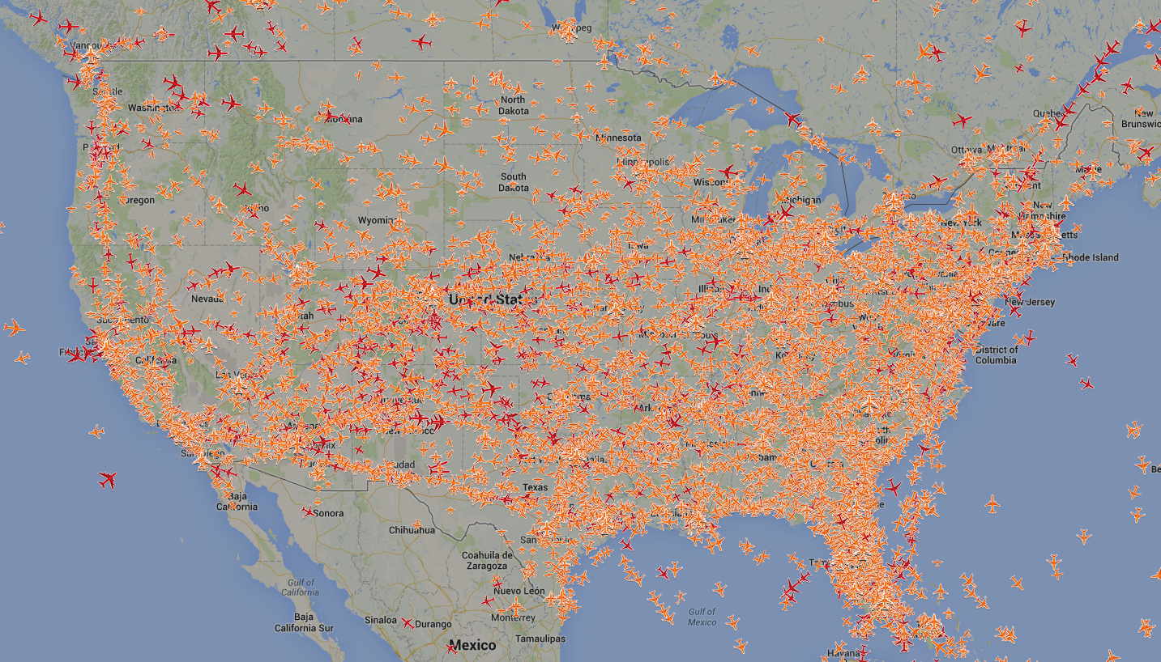
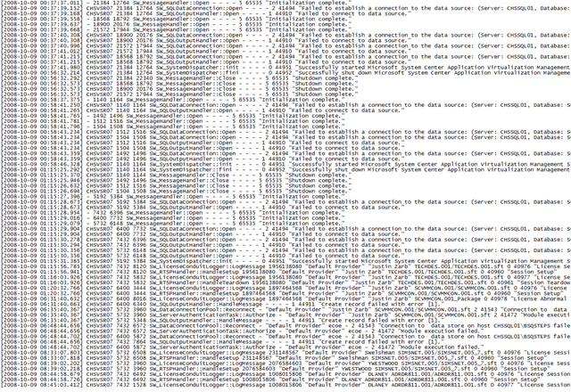

Time Series Data is Everywhere

Slide 22
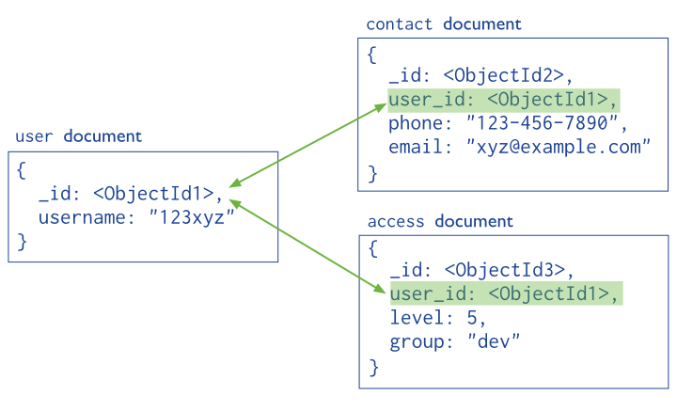
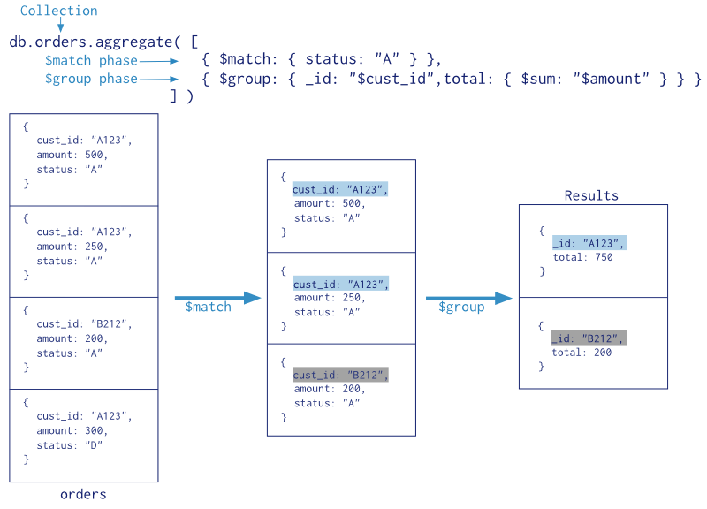
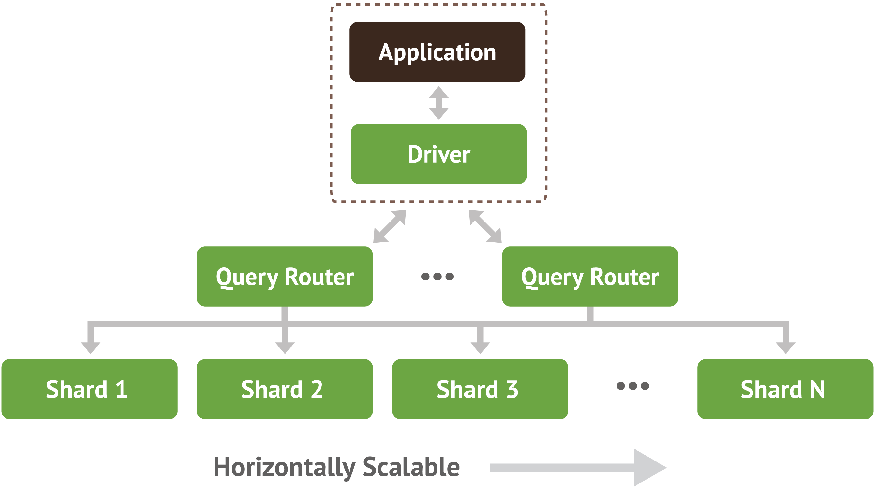
Application Requirements
Schema Design
Event Resolution
Analysis
Dashboards
Analytics
Reporting
Data Retention Policies
Event and Query Volumes
Aggregation Queries
Cluster Architecture

Slide 23
Schema Design Considerations

Slide 24
Schema Design Goal
Store Event Data
Support Analytical Queries
Find best compromise of:
Memory utilization
Write performance
Read/Analytical Query Performance
Accomplish with realistic amount of hardware

Slide 25
Designing For Reading, Writing, …
Document per event
Document per minute (average)
Document per minute (second)
Document per hour

Slide 26
Document Per Event
{
segId: “I80_mile23”,
speed: 63,
ts: ISODate("2013-10-16T22:07:38.000-0500")
}
Relational-centric approach
Insert-driven workload

Slide 27
Document Per Minute (Average)
{
segId: “I80_mile23”,
speed_num: 18,
speed_sum: 1134,
ts: ISODate("2013-10-16T22:07:00.000-0500")
}
Pre-aggregate to compute average per minute more easily
Update-driven workload
Resolution at the minute-level

Slide 28
Document Per Minute (By Second)
{
segId: “I80_mile23”,
speed: { 0: 63, 1: 58, …, 58: 66, 59: 64 }
ts: ISODate("2013-10-16T22:07:00.000-0500")
}
Store per-second data at the minute level
Update-driven workload
Pre-allocate structure to avoid document moves

Slide 29
Document Per Hour (By Second)
{
segId: “I80_mile23”,
speed: { 0: 63, 1: 58, …, 3598: 45, 3599: 55 }
ts: ISODate("2013-10-16T22:00:00.000-0500")
}
Store per-second data at the hourly level
Update-driven workload
Pre-allocate structure to avoid document moves
Updating last second requires 3599 steps

Slide 30
Document Per Hour (By Second)
{
segId: “I80_mile23”,
speed: {
0: {0: 47, …, 59: 45},
….
59: {0: 65, …, 59: 66}
ts: ISODate("2013-10-16T22:00:00.000-0500")
}
Store per-second data at the hourly level with nesting
Update-driven workload
Pre-allocate structure to avoid document moves
Updating last second requires 59+59 steps

Slide 31
Characterizing Write Differences
Example: data generated every second
For 1 minute:
Transition from insert driven to update driven
Individual writes are smaller
Performance and concurrency benefits
Document Per Event
60 writes
Document Per Minute
1 write, 59 updates

Slide 32
Characterizing Read Differences
Example: data generated every second
Reading data for a single hour requires:
Read performance is greatly improved
Optimal with tuned block sizes and read ahead
Fewer disk seeks
Document Per Event
3600 reads
Document Per Minute
60 reads

Slide 33
Characterizing Memory Differences
_id index for 1 billion events:
_id index plus segId and ts index:
Memory requirements significantly reduced
Fewer shards
Lower capacity servers
Document Per Event
~32 GB
Document Per Minute
~.5 GB
Document Per Event
~100 GB
Document Per Minute
~2 GB

Slide 34
Traffic Monitoring System Schema

Slide 35
Quick Analysis
Writes
16,000 sensors, 1 update per minute
16,000 / 60 = 267 updates per second
Reads
5M simultaneous users
Each requests data for 50 sensors per minute

Slide 36
Tailor your schema to your application workload

Slide 37
Reads: Impact of Alternative Schemas
Query: Find the average speed over the last
ten minutes
10 minute average query
Schema | 1 sensor | 50 sensors
1 doc per event | 10 | 500
1 doc per 10 min | 1.9 | 95
1 doc per hour | 1.3 | 65
10 minute average query with 5M users
Schema | ops/sec
1 doc per event | 42M
1 doc per 10 min | 8M
1 doc per hour | 5.4M

Slide 38
Writes: Impact of alternative schemas
1 Sensor - 1 Hour
Schema | Inserts | Updates
doc/event | 60 | 0
doc/10 min | 6 | 54
doc/hour | 1 | 59
16000 Sensors – 1 Day
Schema | Inserts | Updates
doc/event | 23M | 0
doc/10 min | 2.3M | 21M
doc/hour | .38M | 22.7M

Slide 39
Queries will require two indexes
{
“segId” : “20484097”,
”ts" : ISODate(“2013-10-10T23:06:37.000Z”),
”time" : "237",
"speed" : "52",
“pavement”: “Wet Spots”,
“status” : “Wet Conditions”,
“weather” : “Light Rain”
}
~70 bytes per document

Slide 40
Memory: Impact of alternative schemas
1 Sensor - 1 Hour
Schema | # of Documents | Index Size (bytes)
doc/event | 60 | 4200
doc/10 min | 6 | 420
doc/hour | 1 | 70
16000 Sensors – 1 Day
Schema | # of Documents | Index Size
doc/event | 23M | 1.3 GB
doc/10 min | 2.3M | 131 MB
doc/hour | .38M | 1.4 MB

Slide 41
Tailor your schema to your application workload

Slide 42
How much IO is this?
All the queries are against the same data
Extremely low page fault rate: 1%?
10 minute average query
Schema | 1M users (ops/sec) | 1M users (page faults/sec)
1 doc per event | 8,333,333.33 | 83,333
1 doc per 10 min | 1,583,333.33 | 15833
1 doc per hour | 1,083,333.33 | 9722

Slide 43
Summary
Tailor your schema to your application workload
Aggregating events will
Improve write performance: inserts → updates
Improve analytics performance: fewer document reads
Reduce index size → reduce memory requirements

Slide 44

Questions?
@jayrunkel
jay.runkel@mongodb.com
Part 2 – July 9th, 2:00 PM EST
Part 3 - July 16th, 2:00 PM EST

